Slide 1

Improving Website Performance:
Top Ten Actions for Optimal Performance
Lloyd W. Taylor
VP Technology & Operations
Keynote Systems

Slide 2
Poor Performance Hurts your Site
Crash!
Virtually
Offline
(> 30 sec.)
Web Site
Response
Time
Unacceptable
(15 – 30 sec.)
Borderline
(9 – 15 sec.)
The 8 Second Barrier
Good
(0 - 8 sec.)
Web Site Load
(Number of concurrent users)

Slide 3
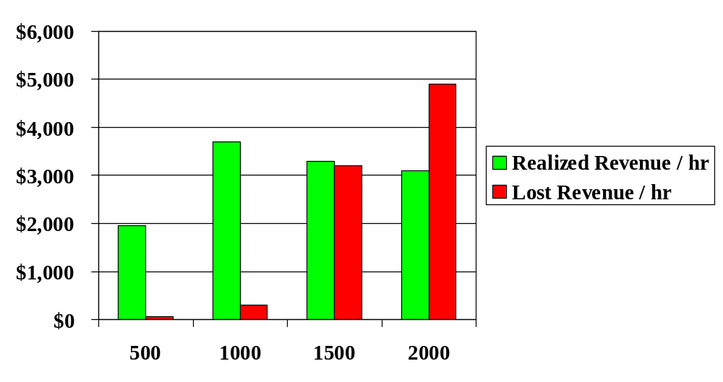
And Your Revenue!
Transactions per Hour

Slide 4


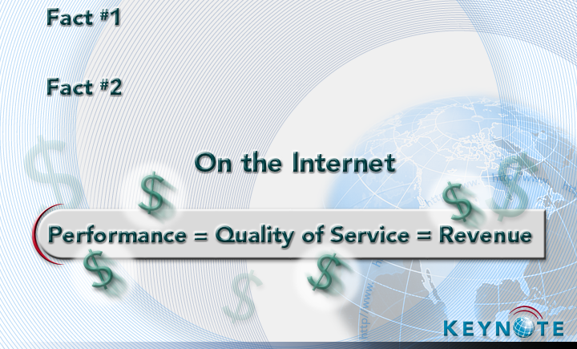
The Reality
Most users click away after
8 second delay
Most users click away after
8 second delay
Most users click away after
8 second delay
$4.4 billion in revenue lost annually due to poor web performance
$4.4 billion in revenue lost annually due to poor web performance
Source: Zona Research
Source: Zona Research
Source: Zona Research

Slide 5
The “Eight Second” Rule
Popularized by Zona Research in Apr 1999
  http://www.keynote.com/services/wp_downloadspeed.doc
Showed rapid increase in abandonment rate after 8 seconds
  < 8 seconds → 6-8% abandonment
  > 8 seconds → 30%+ abandonment!
But, that info is almost two years old

Slide 6
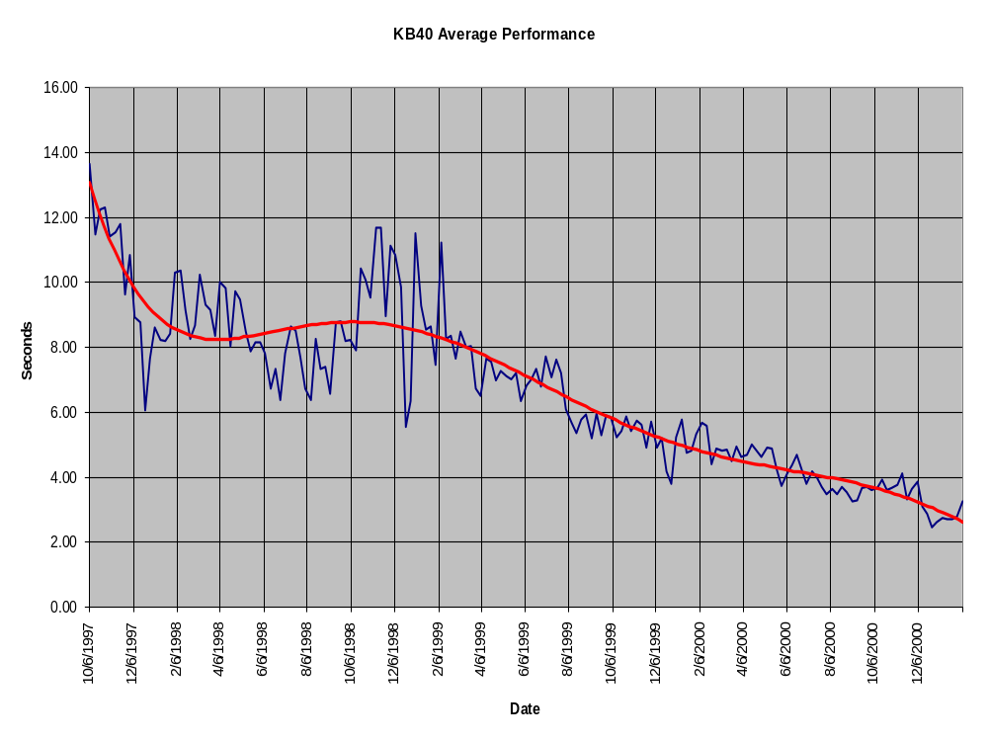
“8 Second Rule” Published by Zona
2.85 Seconds!

Slide 7
The New Rule?
KB40 was ~ 8 seconds when the report was published
KB40 is now ~ 3 seconds
Are our customers abandoning faster than they used to?
Zona is updating their report. Stay Tuned!

Slide 8
Lost & Unhappy Customers
Realistic load test results:
32
Average
Response
Time (sec)
16
8
Number
Of Users
= Completed
= Attempted
= Satisfied
Time →

Slide 9
The Reality
Boston Consulting Group Survey of 12,000 U.S.
Online Shoppers (March 2000)
Reasons for Lost/Failed Transactions
48% “Pages took so long to load that I gave up”
45% “Site was so confusing that I couldn't find product”
26% “System crashed (got logged off) before completion”

Slide 10




The Internet Performance Problem
Web
Server
Web
Browser
External
Third Party
Content
Router
Load
Balancer
FTP Server
e-Mail Server
Application Server
Databases
Streaming
Server

Slide 11
Internet Performance Model
User
Experience
Time
Page Size
Min BW
Turns *
Delay
Processing
Time
=
+
+

Slide 12
Page Size / Min Bandwidth
Page Size is the TOTAL size of your page
  Including images, JavaScript, banners
Minimum Bandwidth is the “smallest pipe” between your content and your customer
  Not just the size of your pipe to the Internet!
  Default Windows RWIN setting will be limiting factor for broadband connections
  TCP Slowstart will be limiting factor for small objects

Slide 13
The RWIN Problem - 1
TCP Receive Window Size (RWIN) limits maximum throughput for Home/Desktop PC users
  As soon as the webserver sends RWIN bytes, it stops until it gets an ACK from the browser
  Windows RWIN default is 8KB
  Typical Webserver can send 8KB in less than 1mS, and then must wait for an ACK

Slide 14
The RWIN Problem - 2
Effect on Throughput
  Max Thruput = RWIN/Latency
  Example: 200mS RT latency, 8KB RWIN
    Max Download Throughput of 328Kb/S
Actual Results of RWIN change:
  @Home connection, 8K RWIN: 450KB/s
  @Home connection, 64K RWIN: 1.6MB/s
http://www.dslreports.com/tweaks/RWIN

Slide 15
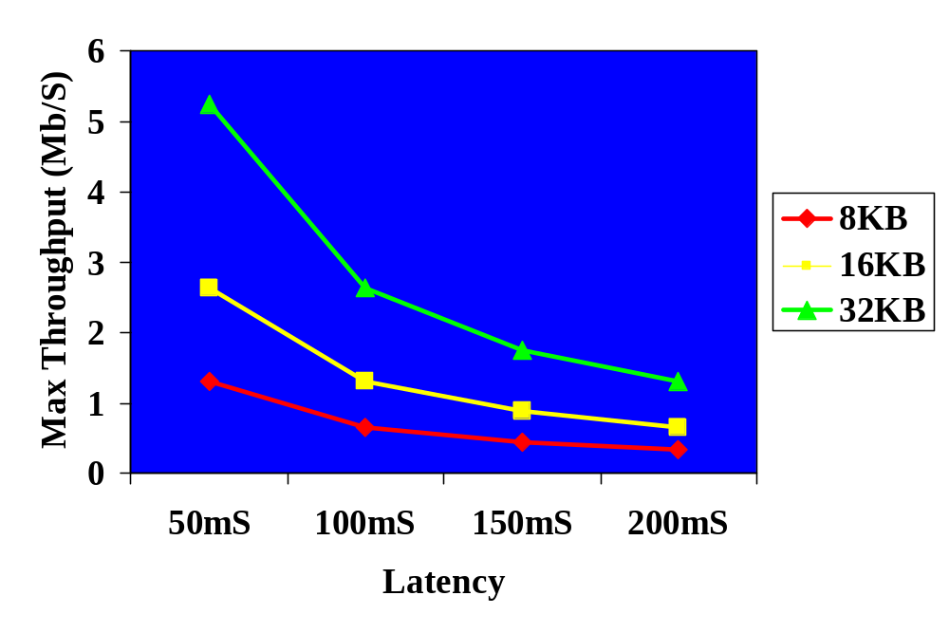
RWIN Graph

Slide 16
Effect of Small RWIN
It is more important to reduce latency than to improve server performance
  Getting the content close to the customer is the only way to do this
HTTP 1.1 will be affected more than HTTP 1.0
  Short streams don’t usually hit RWIN limit
  Long streams do

Slide 17
TCP Slowstart
TCP Slowstart is a congestion avoidance mechanism that is part of TCP/IP
  When a server sends data to a client, it starts by sending one packet, and waiting for an ACK
  Then is sends two, waits for an ACK, then four, etc., up to the RWIN size
  If a packet is lost, the sender immediately cuts the send rate in half, then starts ramping up again

Slide 18
Effect of Slowstart
Objects that are bigger than one packet size will be delivered more slowly than expected
  Typical packet size is ~1500 bytes
HTTP 1.0 will be affected more than HTTP 1.1
  Once a stream is started, there won’t be another Slowstart penalty unless a packet is lost

Slide 19
Page Size / Min Bandwidth
A 100KB page will take at least
  20 seconds @ 40Kb/s
  0.8 second @ 1Mb/s
Performance may be significantly slower due to
  RWIN limits in high-latency connections
  TCP Slowstart if the 100KB page is made of many small objects

Slide 20
Turns * Delay
“Turns” is the number of round trips across the network that are required to download the complete page
  For HTTP 1.0, number of turns is 3 + (2 * #Objects)
    [DNS – 1, TCPOpen – 1, HTTP Get - 1]
  Typical browser allows 4 simultaneous connections, so 4 turns can happen at once
“Delay” is the round-trip latency of the path between the server and the client

Slide 21
What’s a Turn?
Start
SYN
TCP Open
turn
SYN-ACK
ACK
HTTP GET
turn
ACK
ACK
End

Slide 22
Turns * Delay – 2
So, a rough estimate of download time for HTTP 1.0 attributable to turns and delay is:
DT_{TD} = Delay * (3 + (2 * #Objects/4))
DNS – 1
Base Page -2

Slide 23
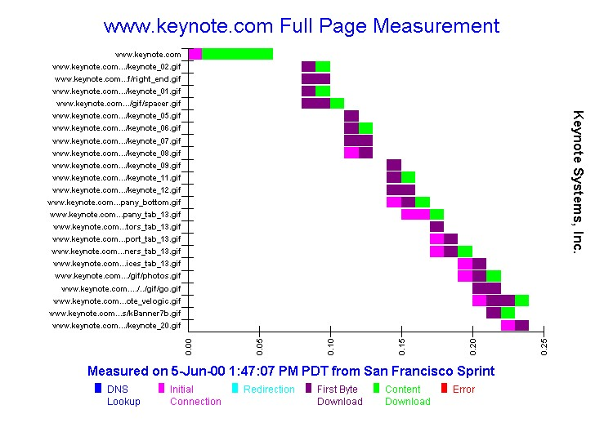
Turns*Delay Example – Local
0.26 Sec
23 Objects

Slide 24
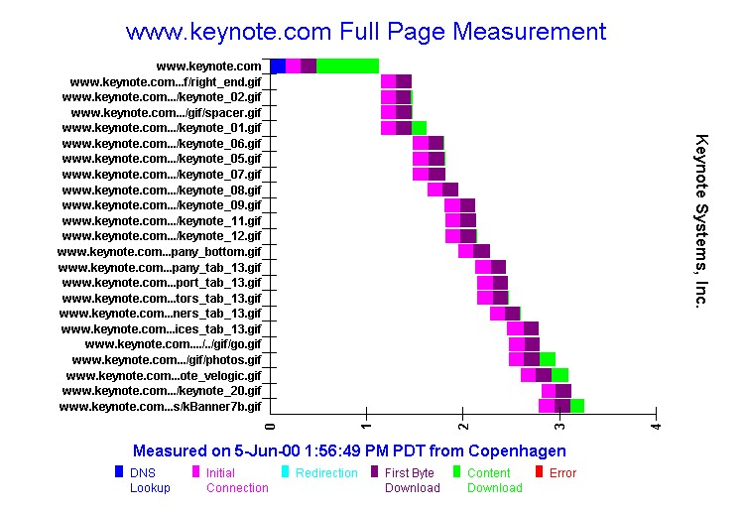
Turns*Delay Example – Dist.
3.22 Sec
23 Objects

Slide 25
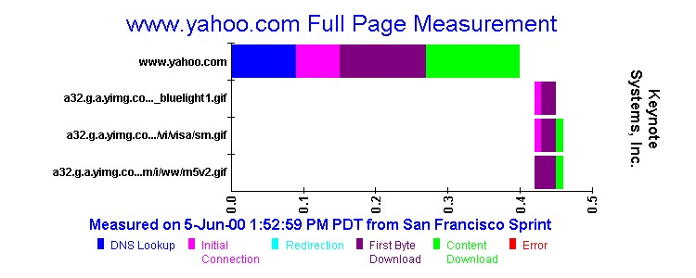
Turns*Delay Example – Local
4 Objects
0.46 Sec

Slide 26
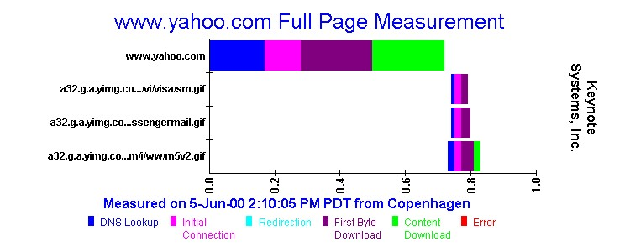
Turns*Delay Example – Dist.
4 Objects
0.83 Sec

Slide 27
Processing Time
Time for the server to process the request
  Static HTML
  Dynamic content (ASP, CGI)
  Backend systems (database)
Time for client to process the data
  Rendering
  Java/shock/etc.

Slide 28
Optimizing Your Site
The “Top Ten” Things that you can do to optimize web site performance

Slide 29
Content Optimizations
10. The smaller the page, the faster the site
  Carefully trade off size with content
    Consider your end users – Business, Consumer, Consumer at Work
    Anything much bigger than 40KB TOTAL will significantly increase abandons by dialup users
    Eliminate White Space in HTML Code
  Minimum Bandwidth is end-to-end!
    Minimum Dialup latency is 600mS
    Force Developers to test over dialup!

Slide 30
Content Optimizations - 2
9. Reduce the number of objects
  Each additional object adds delay by increasing the number of turns required
8. Don’t use Java
  The JVM can take several seconds to start on the client – time which counts against the ‘8 second rule’

Slide 31
Content Optimizations - 3
7. Hold your banner provider accountable
  Those banners are typically served from outside your farm, but count against you in user perception
  Set up an SLA with teeth, and use a third-party firm to measure compliance

Slide 32
Server Optimizations
6. Build a “Load Shedding” Site
  When System Load exceeds a threshold, switch heavily-used pages to a reduced-size version
5. Load Test!
  You don’t know what your server can handle until you try it.
  Test all backend systems using transaction testing.
  Use a load test product that models your user’s behavior.

Slide 33
Server Optimizations -2
4. Put in LOTS of RAM
  Memory is cheap. Put in a lot of it, and make sure your server software is configured to use it ALL.
3. Use Load-Balanced Servers
  Load Balancers have become quite sophisticated, and can greatly improve the performance of your site when properly used.

Slide 34
Network Optimizations
2. Use a Content Delivery Network
  CDNs work by reducing the Delay part of the Turns*Delay equation
  The more objects you have, the more you need a CDN
  The more users you have, the more you need a CDN
    CDNs also help with flash crowds
  Set up an SLA with teeth, and use a third-party firm to measure compliance

Slide 35
Most Important Of All
1. Measure Performance From the Perspective of Your End Users
  What works well in your datacenter may not work well when viewed over dialup or from International locations
  Continually measure not only your front end servers, but also set up measurements that exercise your back-end servers

Slide 36

Thank You!
www.keynote.com
1-800-KEYNOTE

